Slide 1
Handling Adversarial Attacks on Deep Neural Network through Change Point Detection Application to Smart Home Time Series Data
Project Proposal Presentation
CSE 419 Section -02 Fall 2019

Slide 2
Team Members
Name | ID
Mahbuba Tasmin
Sharif Uddin Ruman
Sifat Jahan
N.M. Shihab Islam
Abdur Raufus Saleheen
Taoseef Ishtiak
Md. Sajid Ahmed
Arif Suhan
Shahnewaz Zulminan

Slide 3
Real-Time Change Point Detection with application to Smart Home Time Series Data
Authors - Samaneh Aminikhanghahi, Tinghui Wang, and Diane J. Cook, IEEE Fellow
Publication Journal - IEEE Transactions on Knowledge and Data Engineering (3.865)
Dataset Source- CASAS ( Center of Advanced Studies in Adaptive System)
Dataset Name - Human Activity Recognition from Continuous Ambient Sensor Data Dataset

Slide 4
Abstract
Change Point Detection (CPD) is the problem of discovering time points at which the behavior of a time series changes abruptly.
A novel real-time nonparametric change point detection algorithm called SEP (Separation distance as a divergence measure to detect change points in high-dimensional time series).
Index Terms—Activity transition detection, change detection algorithms, Separation distance, smart homes, time series data

Slide 5
Introduction
Direct density ratio change point detection algorithms
Detect change points between two consecutive windows of data by estimating their probability density ratio based on the assumption that the probability density of two consecutive windows are same if they belong to the same state.
Introduction of new CPD method built on the notion of SEParation distance

Slide 6
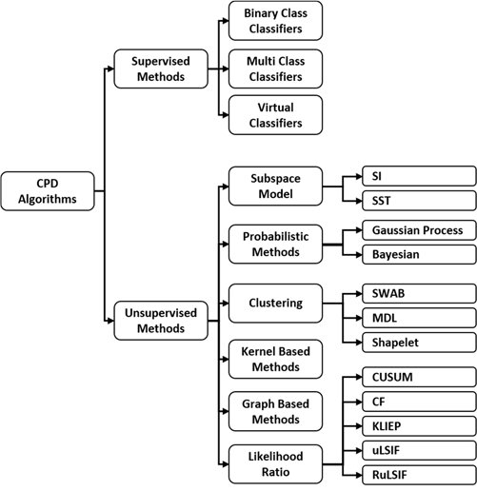
Overview of CPD Algorithms

Slide 7
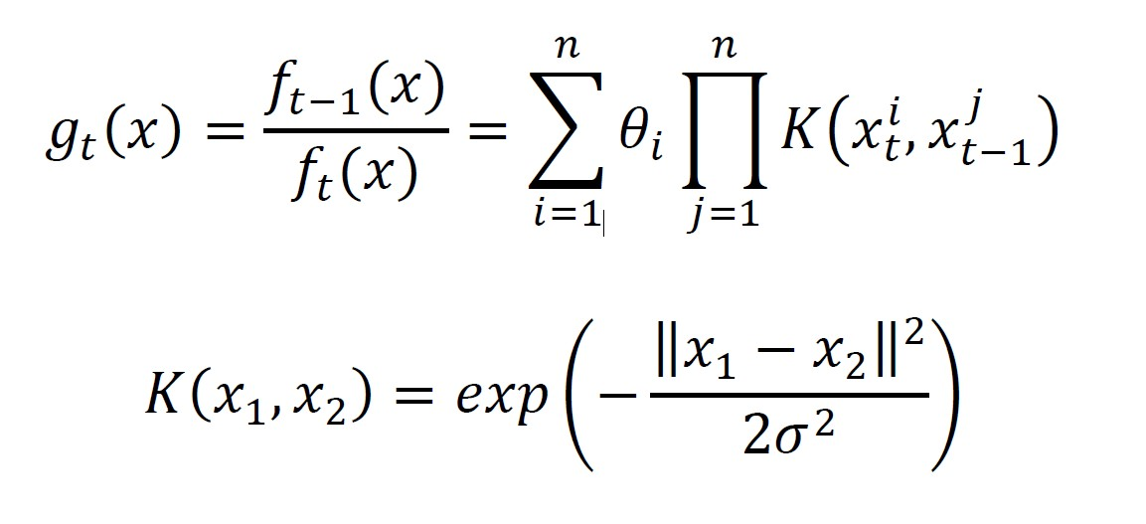
Methodology
Two probability densities, f_{t}(x) and f_{t-1}(x) , corresponding to two consecutive windows, each with length n, density ratio-based CPD methods use “dissimilarity measures” as a measure of difference between them to determine whether or not there exists a change point between these two windows.

Slide 8
Parameters Description
Ѳ=(Ѳ₁,…, Ѳ_{n})^{T} represents the set of parameters for the ratio function to be learned from existing data points in the current windows, and σ>0 represents the kernel parameter.
In the training phase, the parameters Ѳ are determined for each window so that a chosen dissimilarity measure is minimized.
Given a density-ratio estimator g_{t}(x), a dissimilarity measure between windows is calculated during the test phase as a change point score.

Slide 9
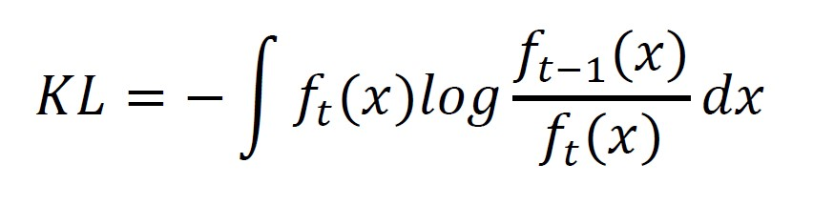
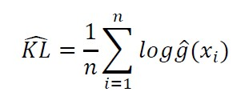
Kullback-Leibler Importance Estimation Procedure (KLIEP)
Estimates the density ratio using Kullback-Leibler (KL) divergence
Convex optimization problem
Unique global optimal solution Ѳ can be obtained by a gradient projection method.

Slide 10
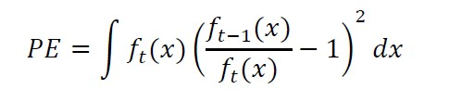
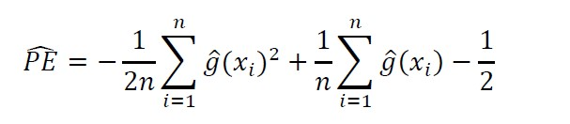
Unconstrained Least-Squares Importance Fitting (uLSIF)
Pearson (PE) divergence as a similarity measure
The density-ratio model is fitted to the true density ratio under the squared loss.

Slide 11
Relative uLSIF (RuLSIF)
The problem of unbounded value of density-ratio balue
α - relative PE divergence for 0≤ α<1 is used as Dissimilarity measure

Slide 12
Result and Findings

Slide 13
Result and Findings

Slide 14
Result and Findings

Slide 15
Adversarial Attacks on Deep Neural Networks for Time Series Classification

Slide 31
Project Outline
Handling Adversarial Attacks on Deep Neural Network through Change Point Detection Application to Smart Home Time Series Data

Slide 32
Architecture

